Slide 1
PEL541
Lesson 5- Adverbs before adjectives

Slide 2
Objectives
The lesson will help learners to:
Learn the deviant use of adverbs before adjectives
Apply the concepts in personal and professional communication settings.

Slide 3

ADVERBS
Types and Usage

Slide 4
Definition
An adverb is a word that describes or gives more information about a verb, an adjective, another adverb, or even the entire sentence.
The word "adverb" comes for the Latin ad- (in addition) and verbum (word).

Slide 5
Adverbs usually answer the following
Where? Home. ("I went home.")
When? Yesterday. ("We met yesterday.")
How? Slowly. ("The turtle moves slowly.")
How often? Sometimes. ("Sometimes it stops responding.")
How long? Temporarily. ("She is staying with us temporarily.")
How likely? Surely. ("Our team will surely win!")
To what degree? Very. ("She was very pleased.")

Slide 6
Adverb describes
An adverb can describe a verb:
She runs quickly.
An adverb can describe an adjective:
She is so beautiful.
An adverb can describe another adverb:
She smokes very rarely.
An adverb can describe an entire sentence: Obviously, you don't have to come.

Slide 7
Form
In many cases (but not always!) adverbs have the following form:
Adjective + "-ly"
Examples:
Quick + ly = quickly Strange + ly = strangely Dead + ly = deadly Sudden + ly = suddenly Clever + ly = cleverly Brave + ly = bravely Real + ly = really

Slide 8
Form (continued)
When an adjective ends with "y" replace the "y" with an "i":
Heavy + ly = heavi + ly = heavily
Happy + ly = happi + ly = happily
When the adjective ends with an "e" drop the "e":
True + ly = tru + ly = truly
However, there are many adverbs that do not end in "-ly":
Fast, very, hard, home, just, too, well, never,
sometimes, and so forth.

Slide 9
Types
Adverbs of degree
Very, highly, totally, perfectly, partially, almost.
Adverbs of manner
Well, badly, nicely, slowly, loudly, quietly, happily, sadly,
secretly, weakly.
Adverbs of place
Home, here, there, outside, inside, away, around, anywhere, abroad, up, down, out.
Adverbs of time
Now, soon, later, yesterday, tomorrow, early, before, lately, recently.

Slide 10
Types (Contd
Adverbs of frequency
Always, never, sometimes, often, rarely, usually, occasionally.
Adverbs of duration
Forever, constantly, temporarily, briefly.
Adverbs of probability
Certainly, maybe, probably, possibly, surely.

Slide 11
Comparative Adverbs
"Comparative" means "comparing something to something else.“
Comparative adverbs show us which action or state is better, worse, stronger, weaker, and so forth.
Examples:
more, less, better, worse, faster, slower, farther, closer. Example sentences:
Maggie works out more seriously than Donna.
She eats less than her friends.
You are better than this.
We couldn't go slower even if we wanted to.
Let's get closer.

Slide 12
Superlative Adverbs
"Superlative" means "of the highest degree.“
Superlative adverbs show us which action or state is the best, the strongest, and so forth.
Examples:
Best, most, least, worst, strongest, fastest, slowest.
Example sentences:
He knows best.
It was the most boring experience.
He shouted the loudest so he won.

Slide 13
Tip #1
Hardly means almost none, and hard means heavily
Rama works hardly ✘ Rama works hard ✔ Rama hardly works ✔
Third sentence is correct as hardly indicates here, Rama is a lazy person.

Slide 14
Tip #2 and #3
Fast is an adverb. Fastly has no meaning
He walks fastly. ✘
He walks fast ✔
Late means after the expected time. Lately means recently.
He came lately ✘
He came late. ✔
Have you seen her lately? ✔

Slide 15
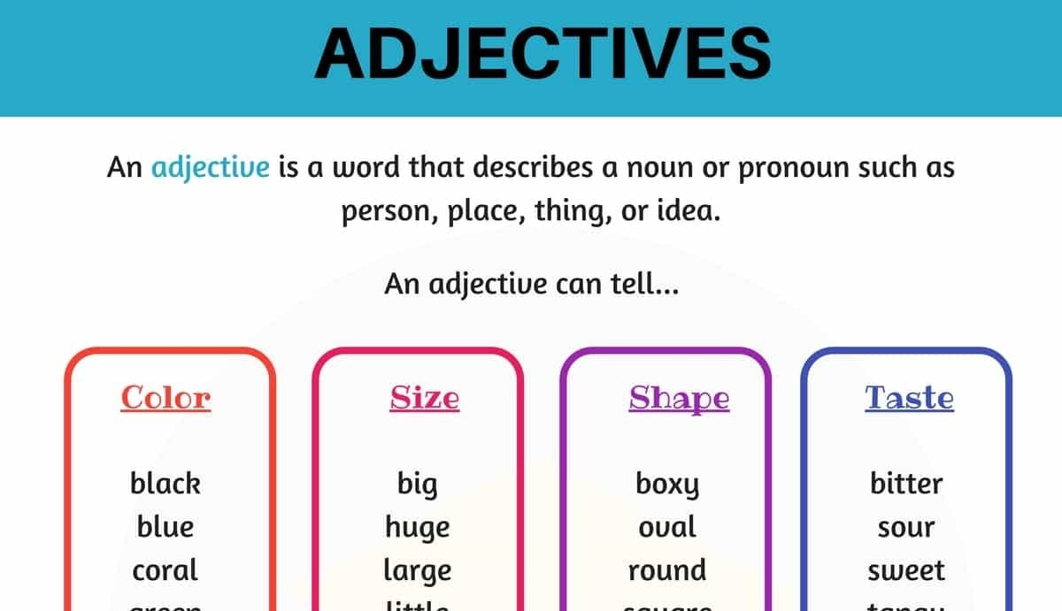
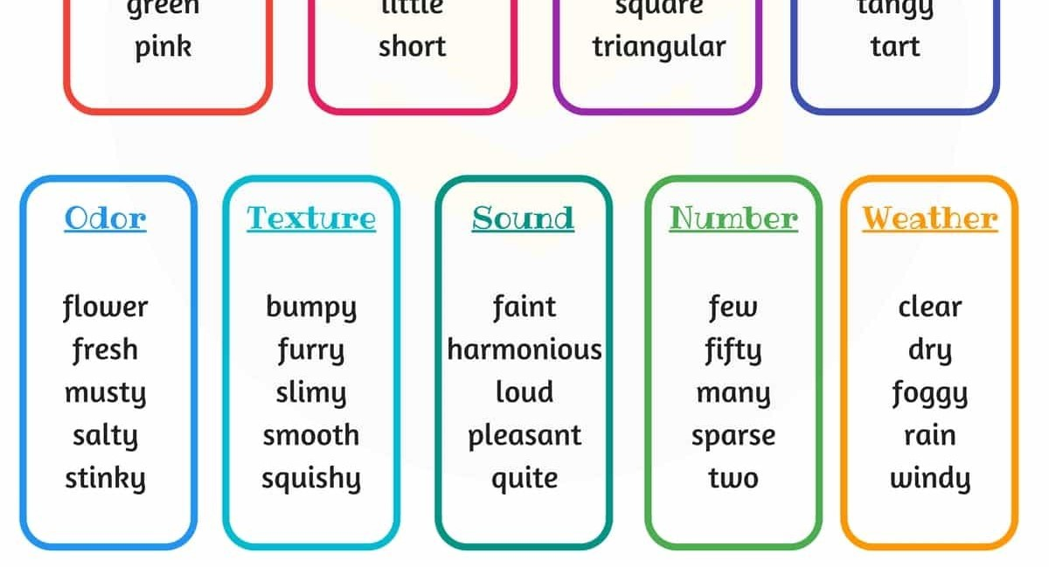

Slide 16

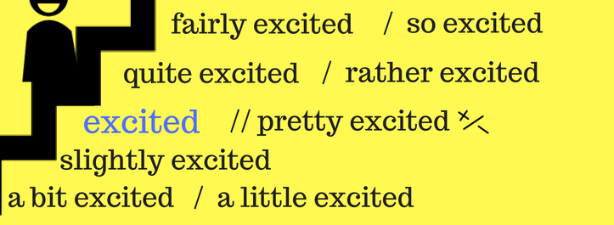
Look at these examples.

Slide 17
Adjectives There are two kinds- Gradable Adjectives Intensifying (Limit) Adjectives

Slide 18
Gradable Adjectives
Intensifying (Limit) adjectives
Gradable adjectives express qualities that can exist in different strengths. For example, a person can be more or less intelligent, a room can be more or less dirty.
Intensifying (Limit) adjectives express the extreme qualities.
For example, if a person is ‘Very very Intelligent’ he is called ‘Brilliant’
So Brilliant which is expressing extreme level of intelligence is a Limit adjective

Slide 19
Some More Examples
Dirty/ Filthy
‘Dirty’ is a gradable adjective, but if something is Very Very Dirty, it is called ‘Filthy’ which is an extreme adjective.
Angry/ Furious
‘Angry’ is a gradable adjective but if someone is very very angry, he/she is ‘Furious’.

Slide 20
Adjectives
Gradable
Stupid
Expensive
Pleasant
Unusual
Upset
clever
Extreme
Ridiculous
Exorbitant
Delightful
Extraordinary
Devastated
brilliant

Slide 21
What are Intensifying Adverbs?
Intensifying Adverbs are the words used to amplify the strength of adjectives and verbs.
-In simple words, to avoid the overuse of ‘Much’, ‘Very Much’ and to sharpen the strength of adjective we use Intensifying Adverbs.
For Example-
Very Cold- Extremely Cold
Very much Disagree-strongly Disagree

Slide 22
The List of Intensifying Adverbs
Totally
Perfectly
Quite
Strongly
Completely
Really
Absolutely
Utterly
Highly
Thoroughly

Slide 23
Caution!!!!!!
Not all intensifying adverbs can be used with all verbs and adjectives.
In fact, Certain Intensifying Adverbs are used with Certain Verbs or Adjectives.

Slide 24
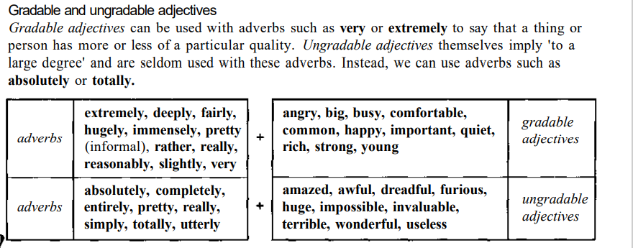

Slide 25
‘Highly’- Collocates with probability words
(un)likely
Unusual
Successful
Competitive
Profitable
Effective
Controversial
recommended

Slide 26
Absolutely/ Utterly- collocates with adjective with extreme meanings
Ridiculous
Stupid
Impossible
Wrong
Alone
Appalled
Convinced
Devastated
miserable

Slide 27
Bitterly- Collocates with the words expressing deep sadness.
Disappointing/ disappointed
Resent
Criticize
Regret
Complain
Cry
weep

Slide 28
Deeply- Collocates with feelings
Ashamed Concerned Shocked Committed Moved Affected Hurt Regret Care Religious unhappy

Slide 29
Ridiculously- suggests something unbelievable or unreasonable
Cheap
Expensive
Easy
Low
High
Long
Short
Small
Large
early

Slide 30
Strongly- collocates with verbs particularly related to opinion.
Oppose
Influence
Believe
Deny
Recommend
Support
Condemn
Suggest
Feel
Argue
Object

Slide 31
The adverbs really and pretty are used with:
Gradable adjectives
Non-gradable adjectives
Both: gradable and non-gradable adjectives

Slide 32
Let’s practice
In each set, one is not a correct collocation
Strongly recommend, strongly influence, strongly love, strongly dislike
Highly educated, highly profitable, highly unusual, highly exhausted
Bitterly regard, bitterly regret, bitterly resent, bitterly criticse
Absolutely convinced, absolutely tired, absolutely devastated, absolutely absurd
Deeply unhappy, deeply religious, deeply successful, deeply committed

Slide 33
Answers
Incorrect pairs are
Strongly love
Highly exhausted
Bitterly regard
Absolutely tired
Deeply successful

Slide 34
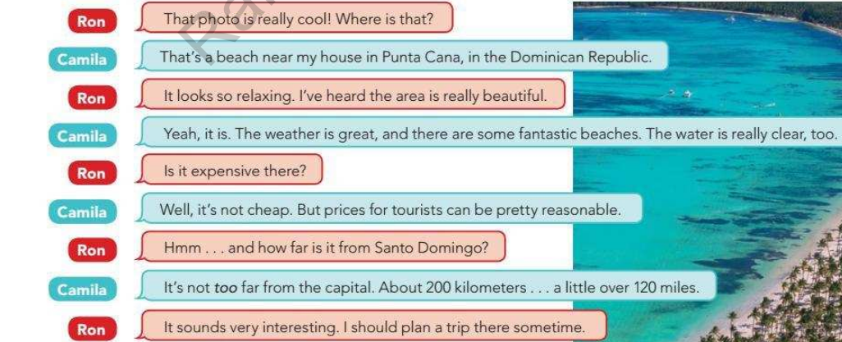

Slide 35
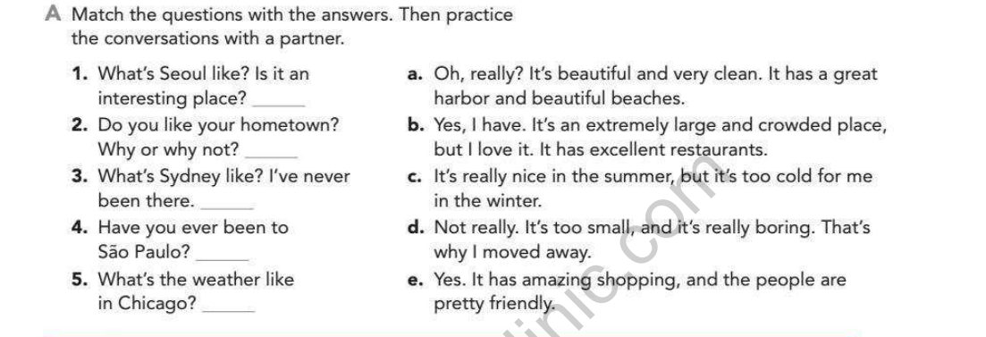

Slide 36


Slide 37



Slide 38
Don't see that film! It's _ __ awful!
Absolutely
Nearly
extremely

Slide 39
Hundreds of _ terrified people ran for their lives.
Completely
Extremely
fairly

Slide 40
Are you sure? / Yes, I'm _ certain.
Nearly
Quite
intensely

Slide 41
It's _ cold outside. In fact, it's nearly freezing.
Quite
Really
fairly

Slide 42
● Circle the adjective or the adverb to complete each sentence.
My classmate is a _____ person. [ nice / nicely ]
2. I can speak Spanish very _____. [ good / well ]
3. Katrina took a painting class, so she can paint _____ pictures. [ beautiful / beautifully ]
4. Mr. Smith looked _____ at me when I arrived late. [ angry / angrily ]
5. Of course, I was _____ when I got an A+ on the exam. [ happy / happily ]
6. The music is too _____. Please turn it down! [ loud / loudly ]
7. My friends all tell me that I sing _____. [ bad / badly ]
8. The thief _____ took the money and walked out the door. [ quiet / quietly ]
9. The cat waited _____ for the mouse to come out of the hole. [ silent / silently ]
10. My cousin always walks very _____. [ quick / quickly ]
11. The work that my boss gave me was _____. [ easy / easily ]
12. Thomas is very _____. He always helps me. [ kind / kindly ]
13. The little boy _____ kept the cookie for himself. [ selfish / selfishly ]
14. The man _____ opened the door and looked inside. [ nervous / nervously ]
15. The fireman _____ rescued the people from the burning house. [ brave / bravely ]
16. I _____ offered to help my friend study for his exam. [ happy / happily ]
17. She is the most _____ person I know. [ polite / politely ]
18. It was midnight, and I heard a _____ noise outside. [ strange / strangely ]

Slide 43
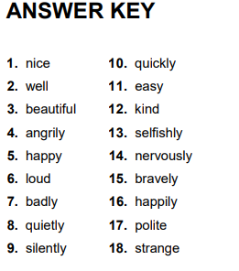

Slide 44
E-Resources
Online Resources
Purdue OWL: Adjective or Adverb
Purdue OWL: How to Use Adjectives and Adverbs
Adjectives and Adverbs Grammarly Handbook | Adjectives and Adverbs Grammar Rules

